Slide 1
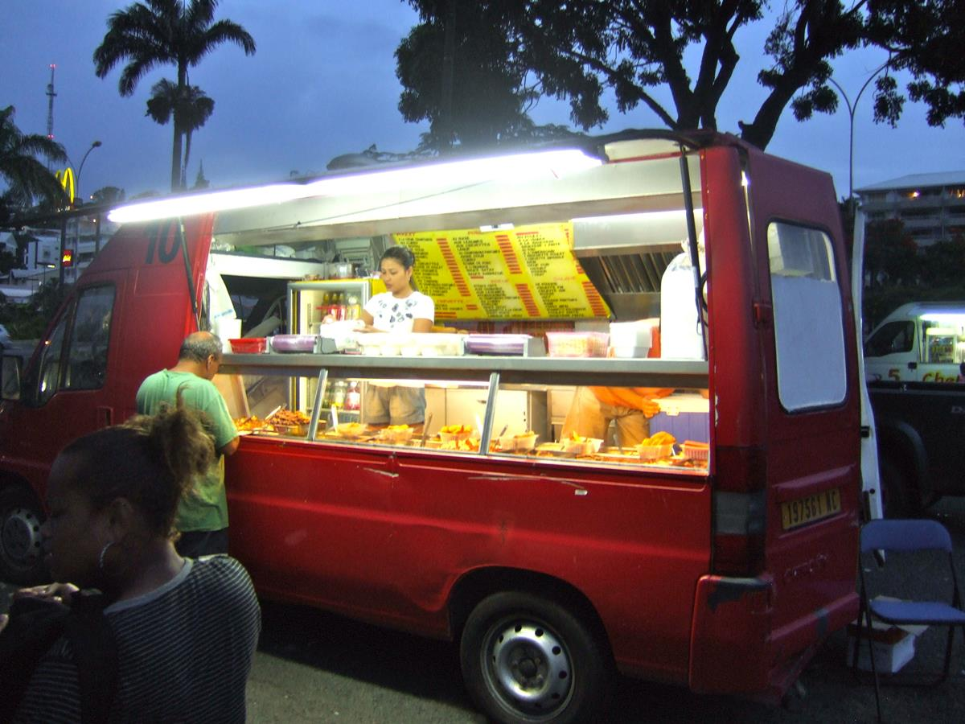
Food trucks locations
Finding Optimal Locations for Food Truck Operators in San Francisco during Covid-19 Pandemic
Shang Horng Patrick Guo

Slide 2
Food truck operation during Covid-19
The Covid-19 pandemic continues to cause widespread economic disruption
Food trucks are services that provide meals from motorized vehicles or carts.
They continuing to operate because unlike restaurants they can quickly change location, menu and market.
Adapted by branching out into residential areas or nearby essential businesses.
Food truck sales heavily depends on location.
Generate promising neighborhoods for food truck operation in San Francisco.

Slide 3
Data acquisition and cleaning
Location candidates in the allowed zones from the latest Mobile Food Facility Permits data provided by San Francisco Department of Public Works on DataSF.
Type and location of nearby venues using Foursquare API.
List of essential businesses as defined by sf.gov.
Geocoder API to get latitude and longitude coordinates of locations.
653 rows and 24 features in raw dataset
Missing, mislabeled or unrelated features were dropped.
Cleaned data contains 4 features.

Slide 4
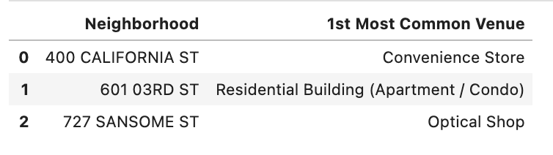
1st most common venue for each neighborhood.
Address 0 and 2 are near essential businesses open during Covid-19 pandemic.
Address 1 is near residential buildings.

Slide 5
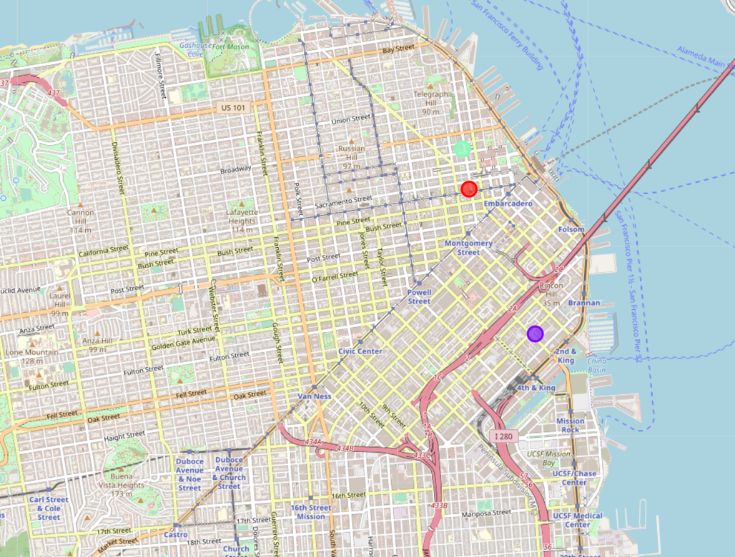
Folium map of clusters of Food truck locations in San Francisco
Two clusters closer to each other
One is farther away
All on the east edge of the city and near the harbour.

Slide 6
Addresses of areas recommended for further analysis
601;605, 3rd Street, South Beach, San Francisco, San Francisco City and County, California, 94017, United States
400;410, California Street, Financial District, San Francisco, San Francisco City and County, California, 90104, United States
705;727;729, Sansome Street, Northeast Waterfront Historic District, San Francisco, San Francisco City and County, California, 94133, United States

Slide 7
Discussion and Conclusion
K-means clustering to show 3 zones for potential food truck locations.
Data is limited because not a lot of food truck permits are approved during the pandemic.
Further analysis is required by taking into consideration of additional factors such as street traffic, enough space for social distancing etc.

Slide 8
Works cited
City and County of San Francisco. “Check if a business can be opened.” Sf.gov. Jan 21, 2021. https://sf.gov/check-if-business-essential Accessed Jan 21 2021.
DataSF. Mobile Food Facility Permit. San Francisco: San Francisco Department of Public Works. Jan 23 2021. https://data.sfgov.org/Economy-and-Community/Mobile-Food-Facility-Permit/rqzj-sfat Accessed Jan 23 2021.
DPW Order No: 182101. San Francisco Department of Public Works. Jan 22 2014. https://www.sfpublicworks.org/sites/default/files/3858-DPW%20Order_182101-MFF.pdf Accessed Jan 21 2021.

